Slide 1
PROVOST’S PROMOTION & TENURE WORKSHOP
FOR TENURE-TRACK FACULTY
FRIDAY, APRIL 5, 2024, 9:00-11:00AM
AGENDA
9:00 Welcome, poll, & workshop goals
9:05
Demonstrating Excellence in the Areas of Evaluation – Provost Joseph Hartman
Research
Teaching
Service
9:35
Process Timeline & Resources – P&T Team
9:55
Panel: Recent Perspectives on the Promotion & Tenure Process
10:45
Open Q&A with panel and presenters
Thank you for attending!
Learning with Purpose
1

Slide 2
A QUICK POLL – SHOW OF HANDS
What brings you here today?
I'm planning to apply for promotion and/or tenure in 2024-25
I’m considering applying in 2024-25, but I’m undecided
I'm not ready to apply, but want to learn about the process
I'm a chair or dean here to support a candidate
If you are planning/considering an application in 2024-25, what type?
Promotion from assistant to associate professor with tenure
Tenure only at current rank
Promotion to full professor

Slide 3
WORKSHOP GOALS
We hope you will come away with:
an understanding of the areas of evaluation
familiarity with the process
a sense of how to present your accomplishments effectively
a sense of the collaborative effort of your peers that goes into the P&T process

Slide 4
AREAS OF EVALUATION
Research, Scholarship, & Creative Activity
Teaching / Instructional Effectiveness
Service

Slide 5
DEMONSTRATING EXCELLENCE
Research, Scholarship, Creative Activity
The candidate should discuss the importance of their research, scholarly works, and/or creative activity and the development of their discipline. This is defined in the MSP contract (VII.B.2.c.(2)):
Including, but not limited to research funded by governmental agencies, professional associations and/or publicly acknowledged by learned and professional societies; book publications by governmental agencies, professional associations, and/or acknowledged publishing houses; and publications in recognized professional and/or academic journals, and published conference proceedings.

Slide 6
DEMONSTRATING EXCELLENCE
Teaching / Instructional Effectiveness
The candidate should discuss activities that, directly or indirectly, create the rich educational environment of UMass Lowell. In accordance with the MSP contract, evaluation of faculty achievement in instructional effectiveness should consider the full breadth of their contributions. The MSP contract (VII.B.2.c.(1)) defines instructional effectiveness as:
Including, but not limited to […] development, improvement and demonstration of subject matter competence, continued improvement of methods and procedures of classroom presentation; active participation in departmental evaluation of course offerings and curricula for the purpose of maintaining their quality, relevance, and viability; conscientious discharging of responsibilities for student advisement throughout the academic year; and special or uniquely valuable contributions to the development or implementation or teaching of needed courses in any college or division of the University, and the like.

Slide 7
DEMONSTRATING EXCELLENCE
Service
The candidate should discuss the impact of their sustained and transformative service to the profession, University, and community. The narrative should not merely list activities undertaken or committee memberships, but should provide readers with a clear picture of how the candidate shapes professional life in the discipline, participates in faculty self- governance, and enacts leadership at these various levels. The narrative should clarify the candidate’s role in key service activities cited, and identify the resulting accomplishments and outcomes; leadership roles should be emphasized.* The contract sets out three areas for recognized service (VII.B.2.c.(3)):
Service to the Profession
Service to the University
Community Service
* The candidate should list both compensated and uncompensated service assignments, and delineate accordingly.

Slide 8
GUIDELINES UPDATES & REMINDERS
2024-2025
Candidates request a 2024-25 P&T fileshare folder:
Complete the simple web form at www.uml.edu/pandt by July 1, 2024.
Candidates may include a brief Covid-19 personal impact statement both in the materials to be sent to reviewers and in their portfolio.
Departments have been urged to hold DPC Elections by end of Spring semester, and send results to their Dean, cc: pandt@uml.edu.

Slide 9
PROMOTION & TENURE PROCESS: EARLY STEPS
(Promotion and/or Tenure Calendar 2024-2025)
Spring 2024 | Candidates complete Appendix 1 & 2a (Waiver Statement & External Review Evaluator Selections Form) and submit to Dept. Chair. Chair & Dean complete Appendix 2b & c.
Mid-May | Chair solicits external reviews from the final list of reviewers. Candidates provide a current CV, a reasonable number of samples of scholarly work, and (optional) brief statements of research accomplishments and Covid impact to Dept. Chair.
Last week of May | Chair sends materials to reviewers who have accepted.
Mid-June | If the Chair has not received at least five external review letter commitments per candidate, they will solicit additional reviewers.
*Candidates intending to apply for Promotion and Tenure in 2024-2025 are reminded to attend the Workshop on Preparing and Submitting Electronic Promotion Materials on May
13 from 9:30am – 11am. Register at: https://www.uml.edu/pandt
Learning with Purpose
Learning with Purpose
9

Slide 10
APPENDIX 1

Slide 11
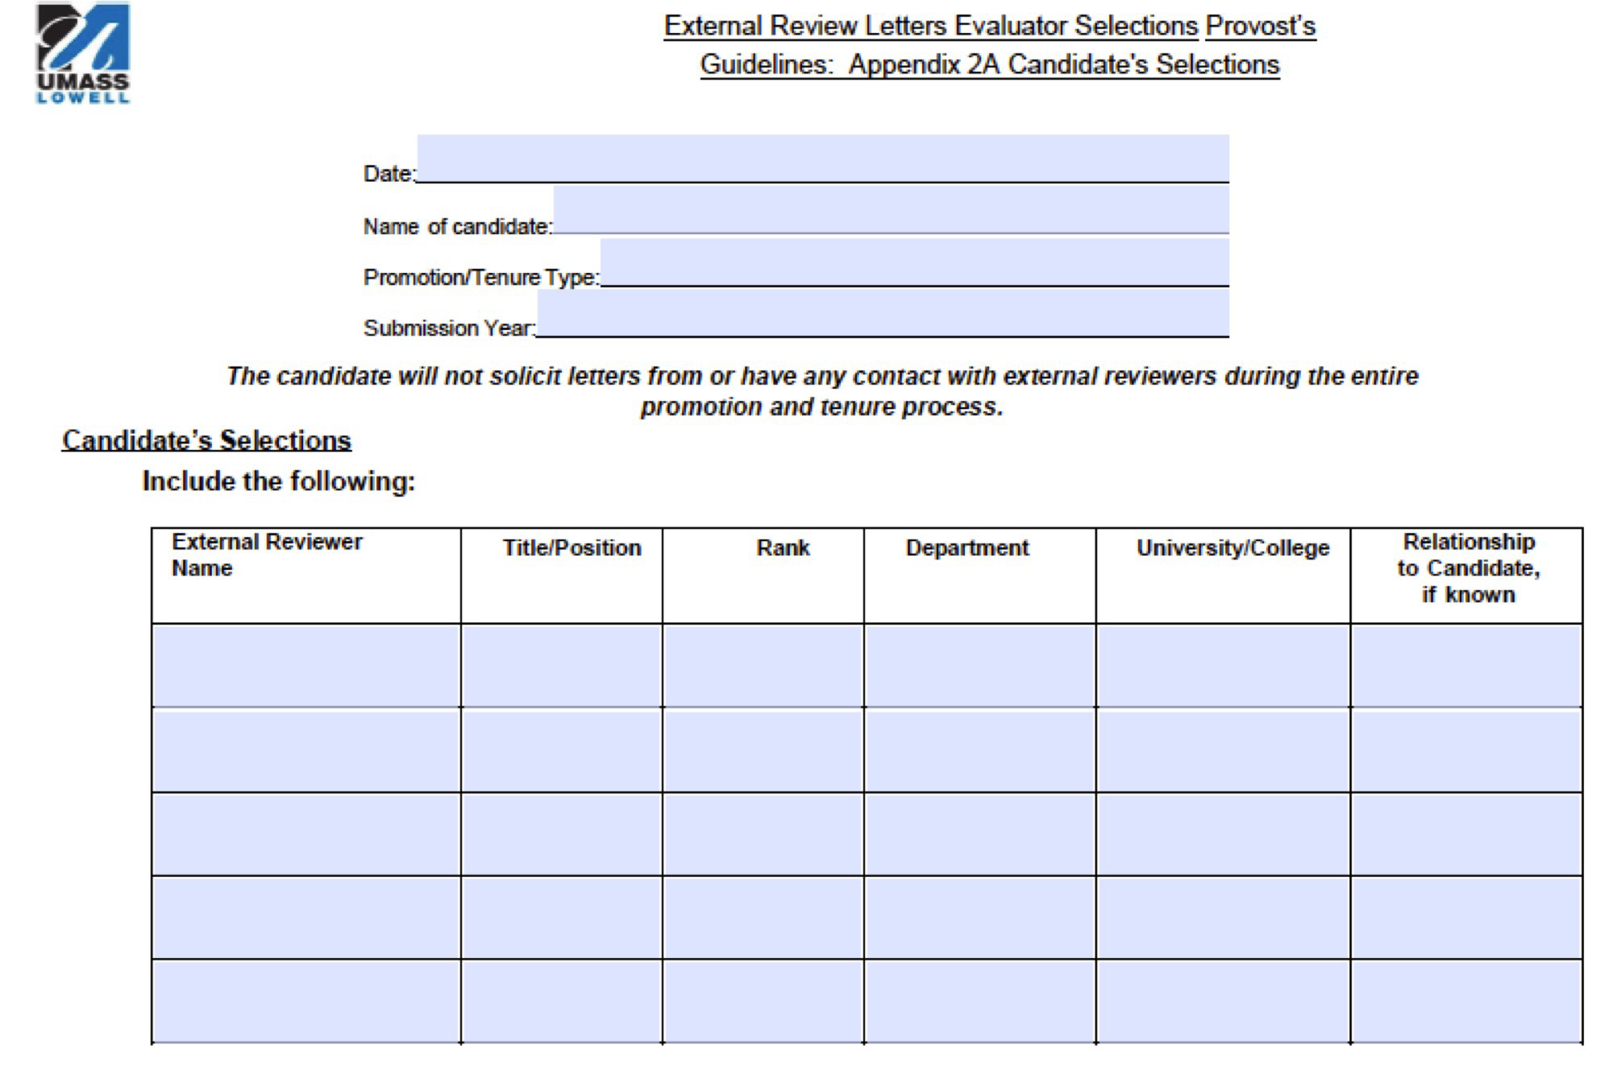
APPENDIX 2A

Slide 12
PROMOTION AND TENURE PROCESS TIMELINE
(contractual dates in bold)
Mid-June | If Chair has not received at least five external review letter commitments per candidate, they will solicit additional reviewers
By July 1 | Candidates request a P&T fileshare folder
Mid-August | Chairs ensure all external letters have been received and seek additional reviewers, if needed.
Sept. 1 | External reviewers should submit their evaluation and CV to Dept. Chairs. Chair reviews external review materials and submits appendix 2c.
Sept. 16 | Deadline for individuals to file for promotion and tenure and to upload all materials for Department Chairpersons. Candidates upload two pdf files by 5pm.
Oct. 7 | Deadline for Chairpersons to submit all individual promotion and tenure materials to DPC (fileshare).

Slide 13
PROMOTION & TENURE REVIEW LEVELS
2024
Oct. 7 – 28 | Department Personnel Committee
Oct. 28 – Nov. 12 | Department Chair
Nov. 12 – Dec. 2 | College Personnel Committee
2025
Dec. 2, 2024 – Jan. 13 | Dean
Jan. 13 – Feb. 6,7 | University Rank and Tenure
Feb. 6,7 – March 3 | Provost
March 3 – April 7 | Chancellor
For Tenure:
Materials are provided to the Board of Trustees for review.

Slide 14
CANDIDATE MATERIALS
Candidates upload two PDF files with the following contents:
Main Portfolio (pdf #1)
Cover page
External Letter Waiver Statement (Appendix 1)
Candidate’s section of the List of Suggested External Reviewers (Appendix 2a)
Candidate’s Curriculum Vitae (CV)
Candidate’s Narrative—recommended length: 5 to 7 pages
Instructional Activity Chart (Appendix 6- updated with FAQ)
Research Funding Report (Appendix 7) (if applicable)

Slide 15
CANDIDATE MATERIALS (CONT.)
Appendix 7: Research Funding Report
Faculty with projects managed through the Office of Research Administration will receive their
Research Funding Report report from ORA for inclusion in their portfolio.
This report creates a standard format for visualizing funded projects.
Request a P&T file share folder to ensure that a report will be prepared for you, if applicable.

Slide 16
CANDIDATE MATERIALS (CONT.)
Electronic Supplemental Materials (pdf #2)
Required:
All annual or periodic evaluations by the Department Personnel Committee, department chair, and dean (include formal annual evaluations and classroom observations of teaching; exclude reappointment letters)
Student evaluations from the period under review—including scanned copies of all pages/ sides of all completed evaluation forms (including numerical ratings and all written comments) NOTE: Per agreement with MSP, faculty are not required to share evaluation results from Spring 2020, Fall 2020, and Spring 2021; candidates may include evaluations from these semesters if they wish.
Optional:
Several samples of the candidate’s most notable scholarly works
COVID-19 personal impact statement
Other significant evidence

Slide 17
PANEL: RECENT PERSPECTIVES ON THE PROMOTION & TENURE PROCESS
Karoline Evans, Management
Recently-promoted & Tenured Associate Professor’s Perspective
Anna Yaroslavsky, Physics & Applied Physics
Recently-promoted Full Professor’s Perspective
Christopher Hansen, Mechanical & Industrial Engineering
Department Chair’s Perspective
Shelley Barish, English
University Rank & Tenure Committee Member’s Perspective
Thank you to all our panelists!

Slide 18
PROMOTION AND TENURE RESOURCES
Where to go for help:
www.uml.edu/PandT
Provost’s guidelines, calendar, user guides, and useful links
Department Chair and Colleagues
Workshop on Preparing and Submitting Electronic Promotion Materials on May 13 from 9:30am – 11am
P&T Team help sessions – individual or small group – Schedule early!!
Paula Haines
Donna Mellen
Shaima Ragab
Email "hotline": PandT@uml.edu

